Slide 1


Notes:
AI-generated content may be incorrect. --- This presentation explores Cyber Threat Intelligence (CTI), a vital discipline for enhancing organizational security. We will cover CTI definitions, lifecycle, sources, applications, and best practices to equip you with strategies for modern cybersecurity challenges. Image source: Microsoft 365 content library

Slide 2
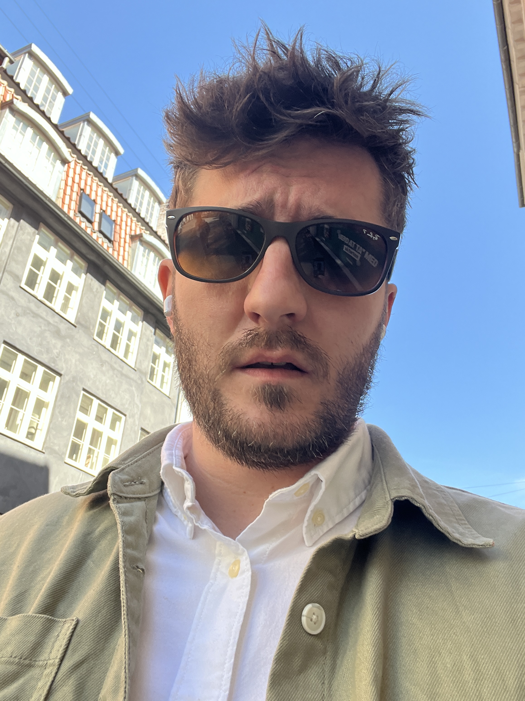
whoami
11 years in Cyber Security
Architecture (SIM3 Auditor)
Co-Founder (OSINTer)
Community Supporter
Guest Lecturer
Education Advisor
CTF Organiser
Blogger
And much much more…

Slide 3
My career so far
JN Data
Incident Response
Operational
Combitech
Operational
Strategic
Elastic
Architecture
Product/Sales
NFCert
Tech Collective
TIBER
Architecture
Product
SOC Architecture
CTI Architecture
Management

Slide 4
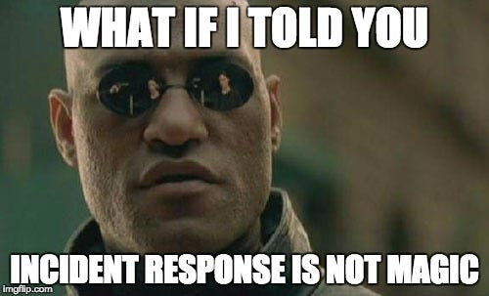
JN Data
Networking
Network Security
SOC
Incident Response
Cyber Threat Intelligence
Team Lead
Architect
Manager
Key point: Communication

Slide 5
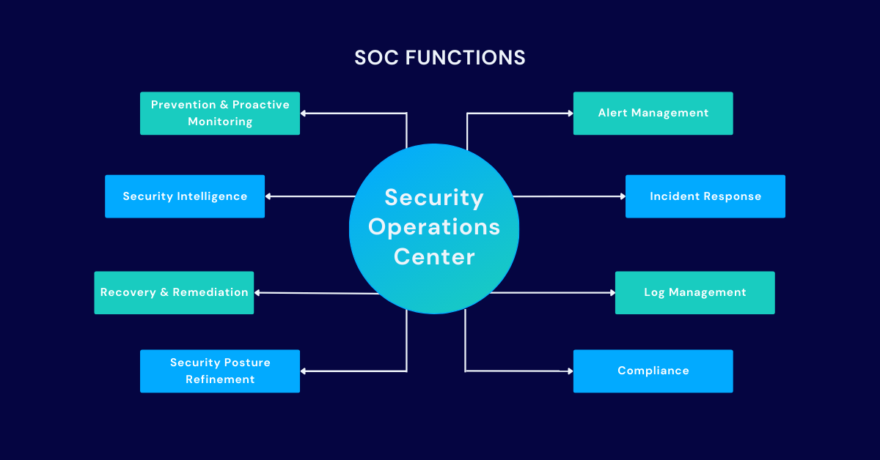
SOC Architecture

Slide 6
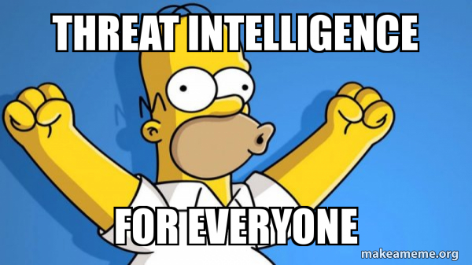
Combitech
Advisory
Incident Response
SOC
Architecture
TIBER (Threat intelligence based ethical red teaming)
CTI Design
White Team Support
Cyber Threat Intelligence
Reporting
Advisory
Key Point: Communication

Slide 7
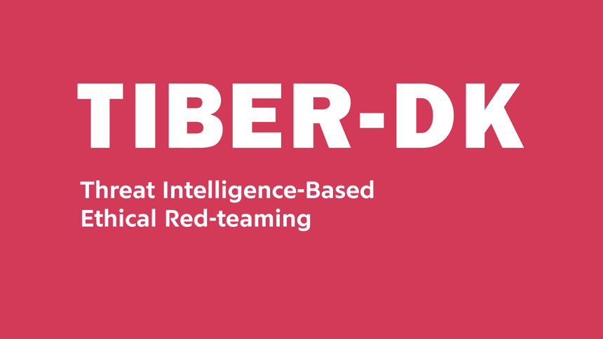
TIBER
OSINT/CTI Report
Red Team/CTI Attack Plan
Red Team Attack
Final Report
Remediations
White Team, Red Team, Blue Team, Purple Team
Key Point: Communication

Slide 8

Elastic
Security/Observability/Search
Pre Sales Architecture
Sizing
Technical Account Management
Ambassador
Conference Talking
Community Support
Key Point: Communication

Slide 9
Elastic - Demo

Slide 10

NFCert
Product Manager
Customer Engagement
Service Architecture
Design Of Existing Services
Planning For Future Services
Key Point: Communication

Slide 11
Tech Collective
Advisory
Vulnerability Management
SOC Building/Architecture
Cyber Threat Intelligence
Reporting
Darkweb Monitoring
SOC Service Architect
24/7 MDR Sevice
Key Point: Communication

Slide 12

Recorded Future Enterprise

Slide 13
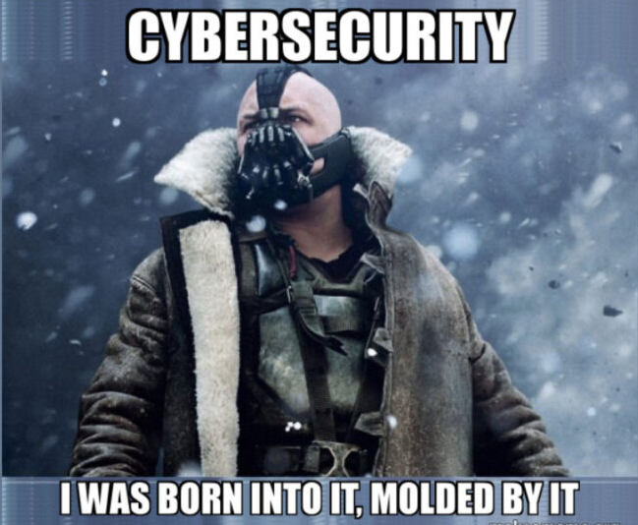
Recommendations For You!
Networking (Not infrastructure!)
Take advantage of OWASP, CitySec, 0-day Aarhus
Always connect to the people you meet on LinkedIn
Foster your own community
Focus on soft skills
Helps with CV – How to sell yourself and communicate who you are better
Keep up with cyber news as much as possible
Find some good sources that interest you
DFIR Report
Bleeping Computer

Slide 14

Second Brain
A Second Brain is a trusted, external system for capturing and organizing knowledge—so your real brain can focus on thinking, not remembering.
How It Works (Simplified):
Capture → Save useful info from anywhere
Organize → Tag and structure it meaningfully
Connect → Link related ideas over time
Resurface → Regularly revisit and reuse notes

Slide 15
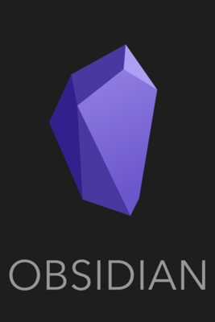
Obsidian
What Is Obsidian?
Obsidian is a local-first note-taking app that turns plain text markdown files into a powerful linked knowledge base.
Create a Vault — your personal note collection
Write Notes — use markdown for formatting
Link Notes — use [[double brackets]] to create connections
Use Tags — like #CTI, #TTPs, #ThreatActors for organization
Explore — use the graph view to spot patterns and clusters

Slide 16
CTF Intro
CTF 1 – Worth 10 points each
Use Obsidian and MISP
CTF 2 – Worth 20 points each
Use Obsidian
CTF 3 – Worth 30 points each
Use Elastic
Final Exercise
As a CISO working in the finance industry in the UK, which threat actors should I be aware of from the threat actors listed in the Obsidian vaults and why? Secondly how do these actors compare to my existing threat landscape featuring Qilin Ransomware Group and APT29.
https://eeeactf.sagalabs.dk/
https://github.com/dclayton454/EAAACTF

Slide 17
Final Exercise
Final Exercise
As a CISO working in the finance industry in the UK, which threat actors should I be aware of from the threat actors listed in the Obsidian vaults and why? Secondly how do these actors compare to my existing threat landscape featuring Qilin Ransomware Group and APT29.
5 minute pitch on Friday
Think about communication!
Think about attacks in the same region, sector.
How much have those attacks cost, if this information is present.
Have any competitors been hit?
Look for overlap between Qilin, APT29 and the actors in the Obsidian Vaults.
Utilize the news articles from both vaults.

